Slide 1
Non comparison based sorting
Linear-Time Sorting Algorithms
Algorithms & Data Structures
ITCS 6114/8114
Dr. Dewan Tanvir Ahmed
Department of Computer Science
University of North Carolina at Charlotte

Slide 2
Counting Sort
Bucket-Sort and
Radix-Sort
1, c
3, a
3, b
7, d
7, g
7, e
∅
∅
∅
∅
∅
∅
∅
B
0
1
2
3
4
5
6
7
8
9

Slide 3
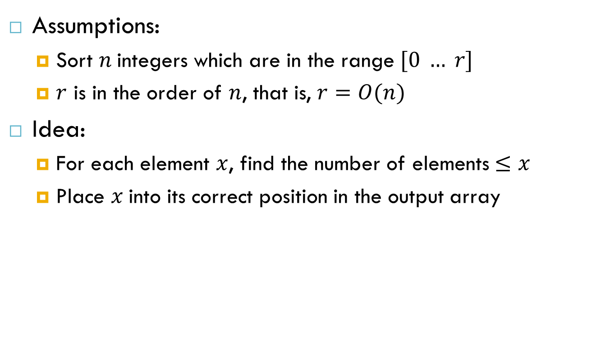
Counting Sort (Cormen Book)
Assumptions:
Sort $n$integers which are in the range $[0 … r]$
$r$ is in the order of $n$, that is, $r=O(n)$
Idea:
For each element $x$, find the number of elements$≤x$
Place $x$into its correct position in the output array

Slide 4

Step 1
Find the number of times A[i] appears in A
Find the number of times A[i] appears in A
Input: A
2 | 5 | 3 | 0 | 2 | 3 | 0 | 3
0 | 1 | 2 | 3 | 4 | 5
0 | 0 | 0 | 0 | 0 | 0
C:
for $1≤i≤n$
C[A[i]]++
0 | 1 | 2 | 3 | 4 | 5
0 | 0 | 1 | 0 | 0 | 0
A[1]
0 | 1 | 2 | 3 | 4 | 5
0 | 0 | 1 | 0 | 0 | 1
A[2]

Slide 5
Step 1(Cont.)
Find the number of times A[i] appears in A
Find the number of times A[i] appears in A
Input: A
2 | 5 | 3 | 0 | 2 | 3 | 0 | 3
0 | 1 | 2 | 3 | 4 | 5
0 | 0 | 1 | 1 | 0 | 1
A[3]
0 | 1 | 2 | 3 | 4 | 5
2 | 0 | 2 | 3 | 0 | 1
Finally
Histogram

Slide 6
Step 2
Find the number $≤A\left[i\right]$; (i.e., cumulative sums)
0 | 1 | 2 | 3 | 4 | 5
2 | 0 | 2 | 3 | 0 | 1
C[ i ] ← C[ i ] + C[i -1]
0 | 1 | 2 | 3 | 4 | 5
2 | 2 | 4 | 7 | 7 | 8

Slide 7
Algorithm
Start from the last element of A
Place A[i] at its correct place in the output array
Decrease C[A[i]] by one

Slide 8
Example
2 | 5 | 3 | 0 | 2 | 3 | 0 | 3
0 | 1 | 2 | 3 | 4 | 5
2 | 2 | 4 | 7 | 7 | 8
A[8](3) means output location C[3]
1 | 2 | 3 | 4 | 5 | 6 | 7 | 8
 |  |  |  |  |  | 3
B: Output Array
0 | 1 | 2 | 3 | 4 | 5
2 | 2 | 4 | 6 | 7 | 8
A[7](0) means output location C[0]
1 | 2 | 3 | 4 | 5 | 6 | 7 | 8
 | 0 |  |  |  |  | 3
B: Output Array
0 | 1 | 2 | 3 | 4 | 5
1 | 2 | 4 | 6 | 7 | 8

Slide 9
Example
2 | 5 | 3 | 0 | 2 | 3 | 0 | 3
0 | 1 | 2 | 3 | 4 | 5
1 | 2 | 4 | 6 | 7 | 8
A[6](3) means output location C[3]
1 | 2 | 3 | 4 | 5 | 6 | 7 | 8
 | 0 |  |  |  | 3 | 3
B: Output Array
0 | 1 | 2 | 3 | 4 | 5
1 | 2 | 4 | 5 | 7 | 8
A[5](2) means output location C[2]
1 | 2 | 3 | 4 | 5 | 6 | 7 | 8
 | 0 |  | 2 |  | 3 | 3
B: Output Array
0 | 1 | 2 | 3 | 4 | 5
1 | 2 | 3 | 5 | 7 | 8

Slide 10
Example
2 | 5 | 3 | 0 | 2 | 3 | 0 | 3
0 | 1 | 2 | 3 | 4 | 5
1 | 2 | 3 | 5 | 7 | 8
A[4](0) means output location C[0]
1 | 2 | 3 | 4 | 5 | 6 | 7 | 8
0 | 0 |  | 2 |  | 3 | 3
B: Output Array
0 | 1 | 2 | 3 | 4 | 5
0 | 2 | 3 | 5 | 7 | 8
A[3](3) means output location C[3]
1 | 2 | 3 | 4 | 5 | 6 | 7 | 8
0 | 0 |  | 2 | 3 | 3 | 3
B: Output Array
0 | 1 | 2 | 3 | 4 | 5
0 | 2 | 3 | 4 | 7 | 8

Slide 11
Example
2 | 5 | 3 | 0 | 2 | 3 | 0 | 3
0 | 1 | 2 | 3 | 4 | 5
0 | 2 | 3 | 4 | 7 | 8
A[2](5) means output location C[5]
1 | 2 | 3 | 4 | 5 | 6 | 7 | 8
0 | 0 |  | 2 | 3 | 3 | 3 | 5
B: Output Array
0 | 1 | 2 | 3 | 4 | 5
0 | 2 | 3 | 4 | 7 | 7
A[1](2) means output location C[2]
1 | 2 | 3 | 4 | 5 | 6 | 7 | 8
0 | 0 | 2 | 2 | 3 | 3 | 3 | 5
B: Output Array
0 | 1 | 2 | 3 | 4 | 5
0 | 2 | 2 | 4 | 7 | 7

Slide 12





Counting Sort and analysis
Alg.: COUNTING-SORT(A, B, n, k)
for i ← 0 to r
do C[ i ] ← 0
for j ← 1 to n
do C[A[ j ]] ← C[A[ j ]] + 1
C[i] contains the number of elements equal to i
for i ← 1 to r
do C[ i ] ← C[ i ] + C[i -1]
C[i] contains the number of elements ≤ i
for j ← n downto 1
do B[C[A[ j ]]] ← A[ j ]
C[A[ j ]] ← C[A[ j ]] - 1
$$(r)$$
$$(n)$$
$$(r)$$
$$(n)$$
Overall time: $(n + r)$
12

Slide 13
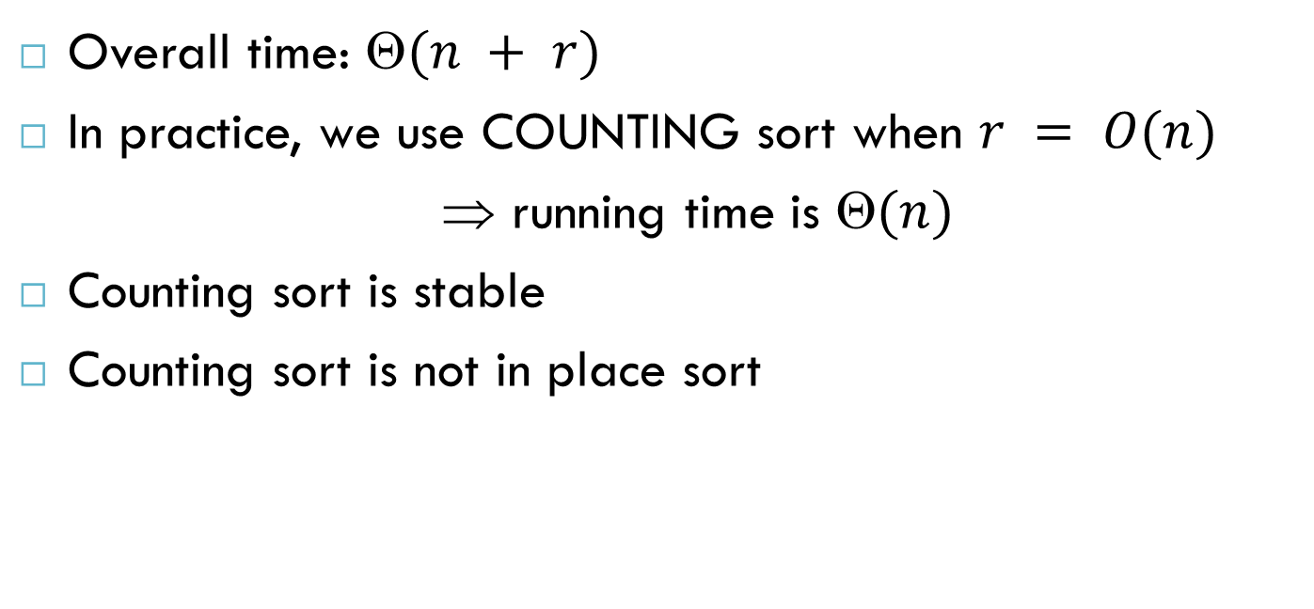
Analysis of Counting Sort
Overall time: $(n + r)$
In practice, we use COUNTING sort when $r = O(n)$
⇒ running time is $(n)$
Counting sort is stable
Counting sort is not in place sort

Slide 14
Bucket-Sort (§ 4.5.1)
Let be S be a sequence of n (key, element) items with keys in the range [0, N − 1]
Bucket-sort uses the keys as indices into an auxiliary array B of sequences (buckets)
Phase 1: Empty sequence S by moving each item (k, o) into its bucket B[k]
Phase 2: For i = 0, …, N − 1, move the items of bucket B[i] to the end of sequence S
Analysis:
Phase 1 takes O(n) time
Phase 2 takes O(n + N) time
Bucket-sort takes O(n + N) time

Slide 15
Bucket-Sort (§ 4.5.1)
Algorithm bucketSort(S, N)
Input sequence S of (key, element) items with keys in the range [0, N - 1] Output sequence S sorted by increasing keys
B ← array of N empty sequences
while ¬S.isEmpty()
f ← S.first()
(k, o) ← S.remove(f)
B[k].insertLast((k, o))
for i ← 0 to N - 1
while ¬B[i].isEmpty()
f ← B[i].first()
(k, o) ← B[i].remove(f)
S.insertLast((k, o))

Slide 16
Example
Key range [0, 9]
7, d
1, c
3, a
7, g
3, b
7, e
Phase 1
1, c
3, a
3, b
7, d
7, g
7, e
B
0
1
2
3
4
5
6
7
8
9
∅
∅
∅
∅
∅
∅
∅
Phase 2
1, c
3, a
3, b
7, d
7, g
7, e

Slide 17
Properties and Extensions
Key-type Property
The keys are used as indices into an array and cannot be arbitrary objects
No external comparator
Stable Sort Property
The relative order of any two items with the same key is preserved after the execution of the algorithm
Extensions
Integer keys in the range [a, b]
Put item (k, o) into bucket B[k − a]

Slide 18
Radix-Sort for Binary Numbers
Consider a sequence of n b-bit integers x = x_{b − 1} … x₁x₀
We represent each element as a b-tuple of integers in the range [0, 1] and apply bucket-sort with N = 2
This application of the radix-sort algorithm runs in O(bn) time
For example, we can sort a sequence of 32-bit integers in linear time

Slide 19
Radix Sort
Idea: sort on the “least significant digit” first and on the remaining digits in sequential order.
The sorting method used to sort each digit must be “stable”.

Slide 20

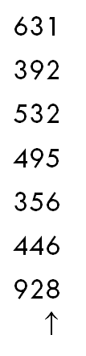

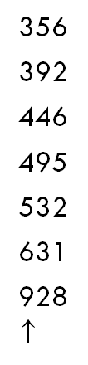
An Example
After sorting
on middle
digit
After sorting
on LSD
After sorting
on MSD
Input

Slide 21
Radix-Sort for Binary Numbers
RadixSort(A, d)
1. for i ← 1 to d
2. do use a stable sort to sort array A on digit i
Algorithm binaryRadixSort(S)
Input sequence S of b-bit integers Output sequence S sorted replace each element x of S with the item (0, x)
for i ← 0 to b - 1
replace the key k of each item (k, x) of S with bit x_{i} of x
bucketSort(S, 2)

Slide 22
Example
Sorting a sequence of 4-bit integers
1001
0010
1001
1001
0001
0010
1110
1101
0001
0010
1101
1001
0001
0010
1001
0001
1101
0010
1101
1101
1110
0001
1110
1110
1110

Slide 23
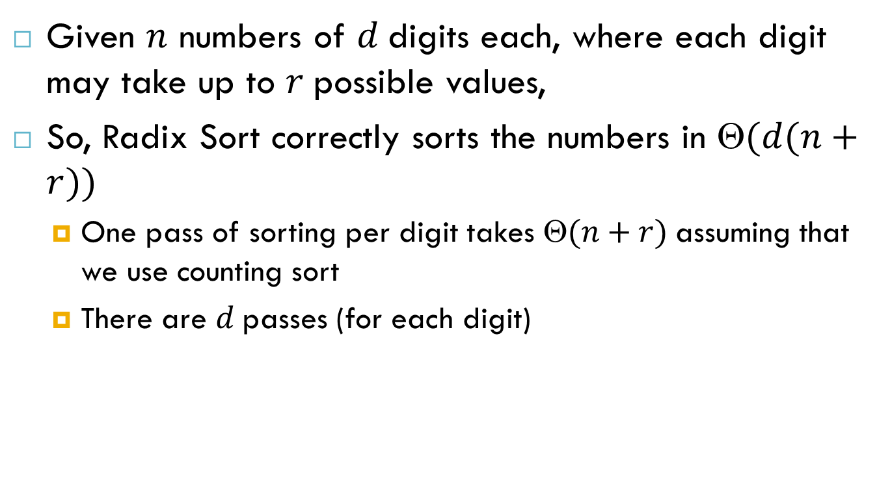
Analysis of Radix Sort
Given $n$ numbers of $d$digits each, where each digit may take up to $r$possible values,
So, Radix Sort correctly sorts the numbers in $(d(n+r))$
One pass of sorting per digit takes $(n+r)$assuming that we use counting sort
There are $d$passes (for each digit)

Slide 24
Reference
Algorithm Design: Foundations, Analysis, and Internet Examples. Michael T. Goodrich and Roberto Tamassia. John Wiley & Sons.
Introduction to Algorithms. Thomas H. Cormen, Charles E. Leiserson, Ronald L. Rivest, Clifford Stein.

Slide 25
Thank you!

